Slide 1
Kitchen Safety Guide
Project code: MWH01a-22
Supervisor: Professor Mow Wai Ho
Author: CHUI, Chi To Anson; CHUNG, Wai Lok; CHOY, Yu Hin

Slide 2
Background/Problem
Kitchen safety is a high-profile issue
Unattended fire will cause serious potential dangers
Not enough household affordable kitchen safety equipment
Most of the recent equipments include expensive sensor and parts
The image recognition technology is becoming more accurate during the period of covid-19
AI model is applied to our project to lower the price of product

Slide 3
Recent kitchen safety product
Thermal imaging for improving kitchen safety
iGuardStove (A system make use of different kinds of sensors to measure the environment of the kitchen)
Fall detection system by thermal and depth cameras

Slide 4
Aim
Demonstrate the feasibility of using RGB cameras with AI to detect stove fires in a kitchen
Provide an effective method for detecting and preventing stove fires, potentially saving lives and preventing significant property damage

Slide 5
Product description
an Raspberry Pi AI-embedded surveillance system
An Object Detection Module which can identify a human, hand, fire, and cooking utensils (e.g. pot)
Unattended cooking algorithm which can identify unattended cooking event

Slide 6
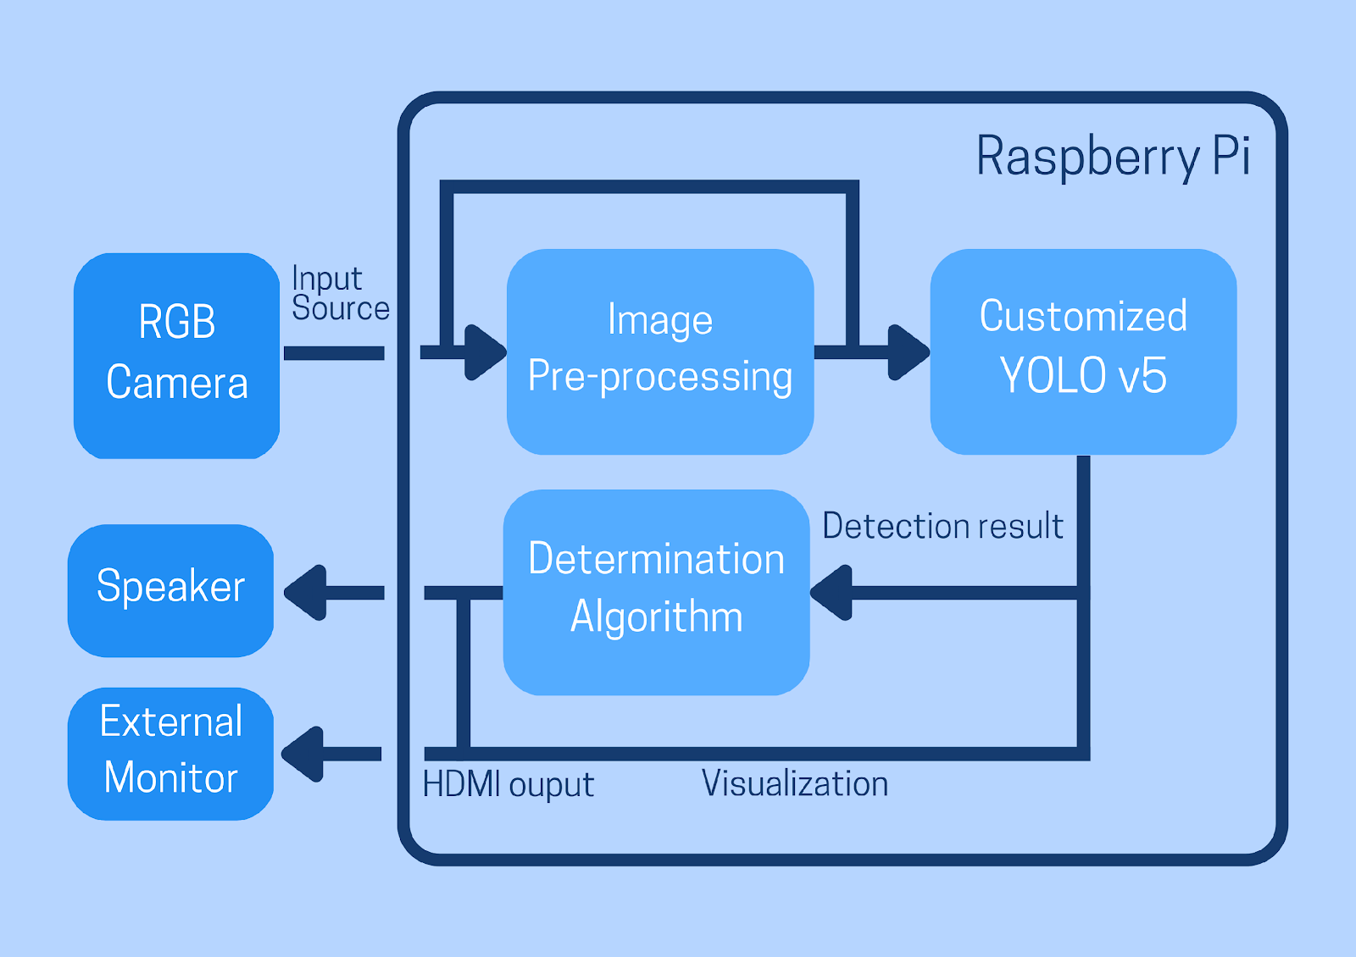
System
Input: NumPy array from MIPI RGB camera
Pre-process:
Resize, brightness, contrast and normalization
Inference: A custom AI YOLOv5 model for individually detecting fire, human, hand and pot
Algorithm: A danger score determined by the existence of each object
Output: audio output (optional video display)

Slide 7
Objective
Object Detection Framework
Unattended Cooking Algorithm
Hardware system to support the software

Slide 8
Object Detection Module
Using YOLOv5 Github Repository
Creating customized dataset
Training AI weight with customized dataset

Slide 9

YOLOv5
Open-Source Repository by Ultralytics
Power by Pytorch
Functionality: train.py, detection.py, export.py, etc.

Slide 10
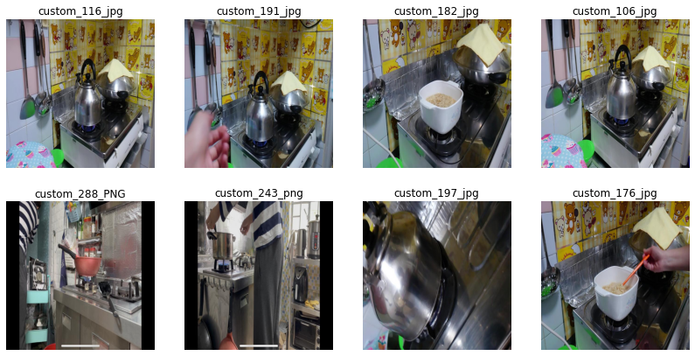
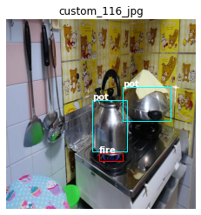
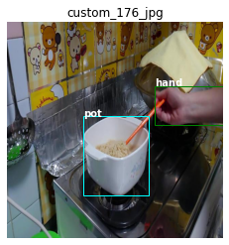

Create Dataset
Collecting Image
Online image + Self-recorded clips
Labeling
Using Roboflow for Dataset management

Slide 11
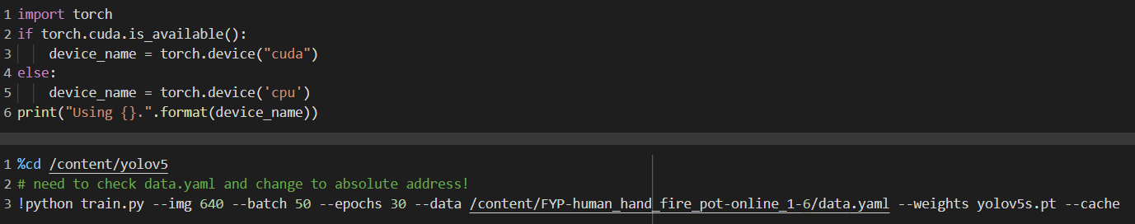
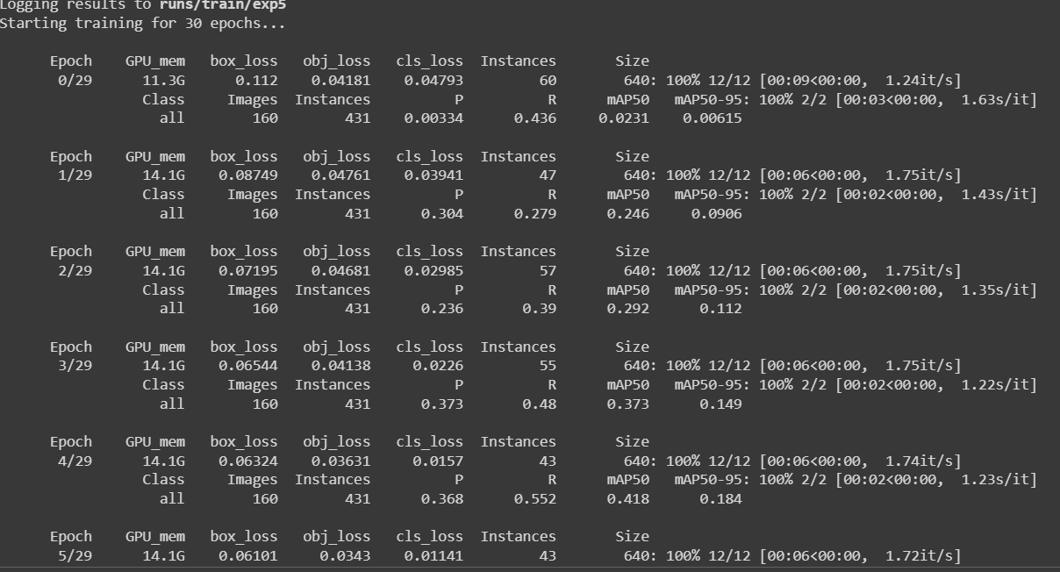
Training AI with processed dataset
In Google Colab Environment (.ipynb)

Slide 12
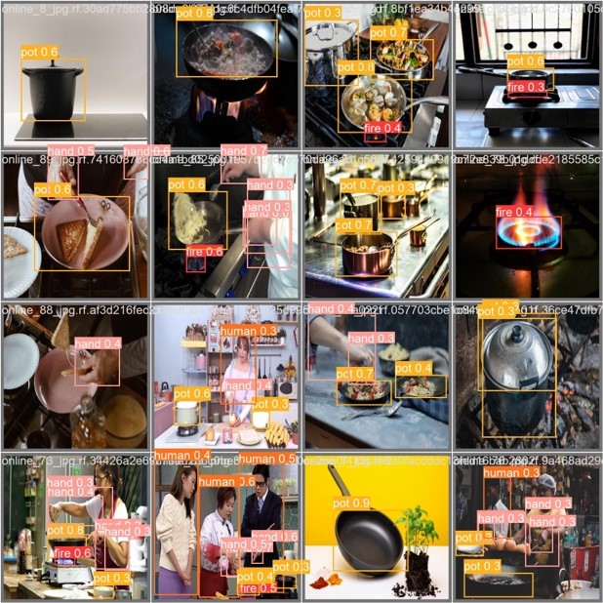
Training AI with processed dataset
First Train

Slide 13
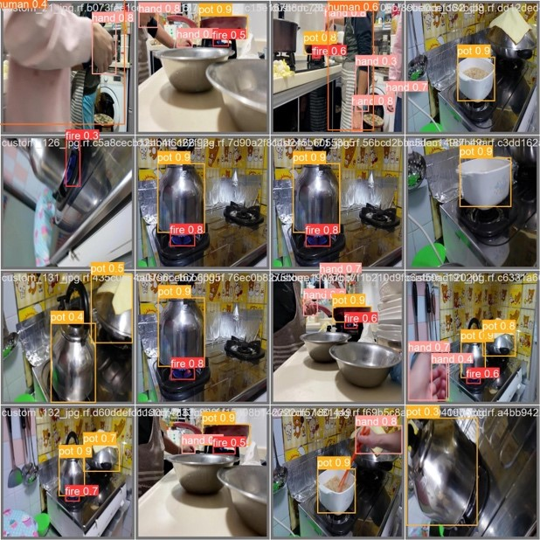
Training AI with processed dataset
Second Train

Slide 14
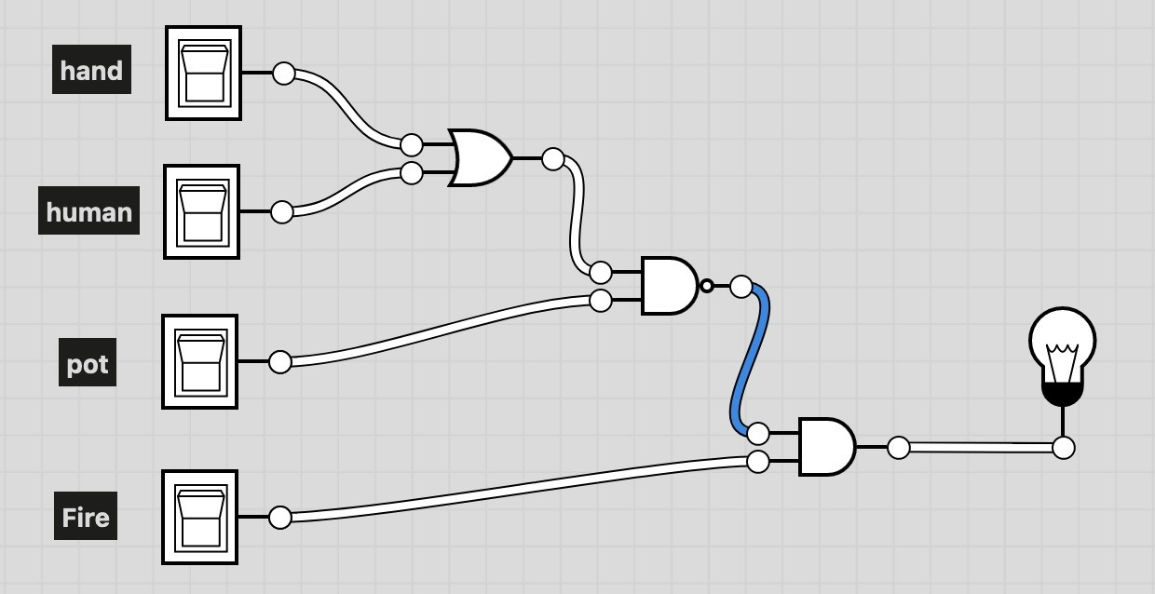
Unattended Cooking Algorithm
Version 1: Logic representation of unattended cooking event

Slide 15
Unattended Cooking Algorithm
Version 2: real-time weighted score
e.g. currentScore = (fire * 2 + hand * 0.75 + human * 1 + pot * 1.2)
Version 3: forgetful weighted score
e.g. currentScore = pastScore * 0.5 + (fire * 4 + hand * 0.75 + human * 1 + pot * 1.2)
Version 4: “forgetful” weighted score with negative weights

Slide 16
Unattended Cooking Algorithm
Version 5: Zero-sum Algorithm
pastScore = currentScore > 0 ? currentScore * 0.5 : 0 currentScore = pastScore + (fire * 0.3 - (hand or human) * 0.5 + pot * 0.2) currentScore = currentScore > 0 ? currentScore : 0

Slide 17
Problem of algorithms explained (Why we update our algorithm)
Version 1
It did not emphase the importance of fire
Version 2
Blocking “fire” does not means there is no fire
Version 3
High warm-up time
Version 4
enlarging value over time

Slide 18
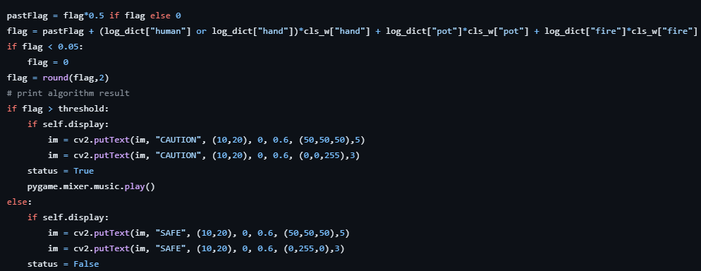
Implementation

Slide 19
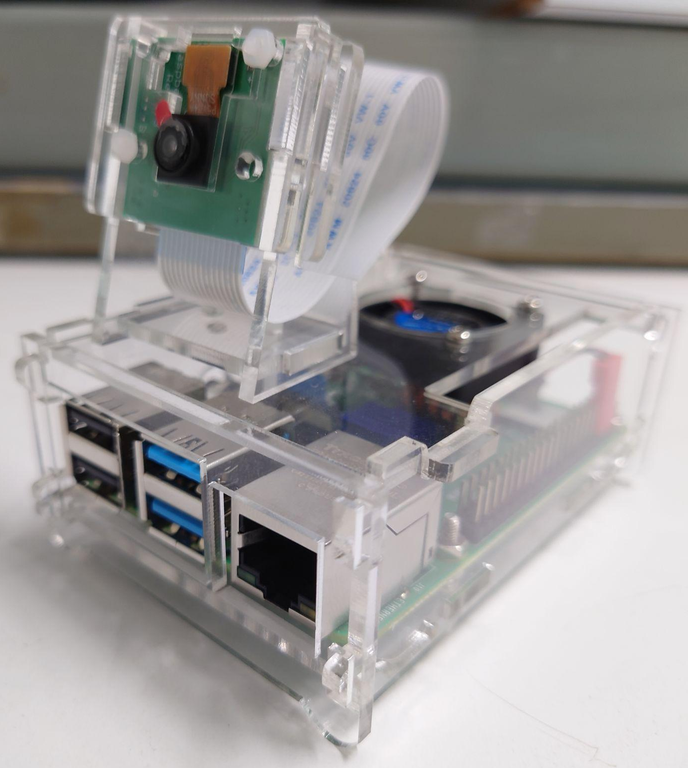
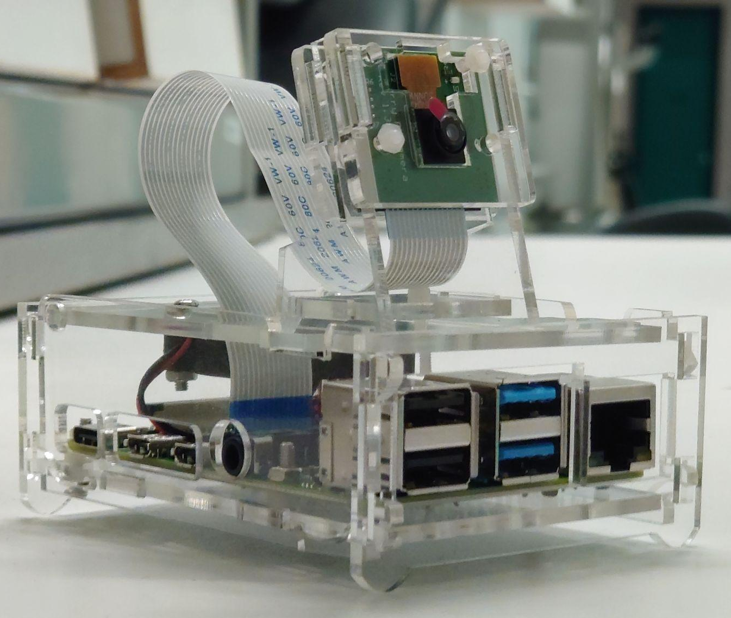
Building of hardware system

Slide 20
Further discussion and improvement
False positive and false negative
more images of “human” labels and “hand” labels
introduce images fom the camera to be implemented (i.e. from MIPI camera)
Slow processing rate
AI model format
hardware improvement / hardware acceleration

Slide 21
Live Demonstration

Slide 22
Chui’s Work

Slide 23
Chung’s Work
AI training and database management
deduplication of input images
Training on Google Colab
Proving the usefulness by testing against video

Slide 24
Choy’s Work
-Collect dataset
-setting up the camera and raspberry pi

